Slide 1
FULL STACK DEVELOPMENT COURSE
DAY 03-b
IRFANSJAH
irfansjah@gmail.com
081293728732

Slide 2
OPERATING SYSTEM TERMINAL / CONSOLE
FILESYSTEM
FILE TYPE :
EXECUTABLE FILES (EXE, COM, CONSOLE SCRIPT/BAT)
NON EXECUTABLE FILES (DOCUMENT, IMAGE, ETC)
FILENAME : [FILEPATH]\ [FILENAME].[EXT]
Mimetypes : example
application/txt
image/jpg
FOLDER STRUCTURE
FILE vs FOLDER
FOLDER STRUCTURE
HOW TO WRITE PATH IN WINDOWS VS IN LINUX
RELATIVE PATH vs ABSOLUTE PATH

Slide 3
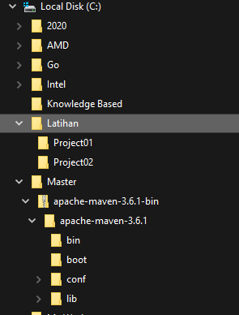
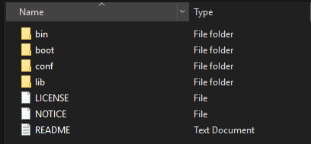
OPERATING SYSTEM TERMINAL / CONSOLE
FILESYSTEM
FOLDER STRUCTURE :
FILE vs FOLDER
FOLDER STRUCTURE
HOW TO WRITE PATH IN WINDOWS VS IN LINUX
RELATIVE PATH vs ABSOLUTE PATH

Slide 4

OPERATING SYSTEM TERMINAL / CONSOLE
FILESYSTEM
WINDOWS :
DRIVE:\FOLDER1\FOLDER2\FOLDER3\FILE
LINUX:
/FOLDER1/FOLDER2/FOLDER3/FILE
URI:
PROTOCOLS://DOMAIN/FOLDER1/FOLDER2/FILE
http://www.google.com/product/index.html
RELATIVE PATH :
. = CURRENT LOCATION
.. = PARENT
EXAMPLE
./FOLDER3/FILE
../../FOLDER1/FILEX
FILE vs FOLDER
FOLDER STRUCTURE
HOW TO WRITE PATH IN WINDOWS VS IN LINUX
RELATIVE PATH vs ABSOLUTE PATH

Slide 5
OPERATING SYSTEM TERMINAL / CONSOLE
TERMINAL / CONSOLE
WINDOWS
UNIX SYSTEM
COMMAND.COM
POWERSHELL
LINUX CLONE TERMINAL - BASH
BASH
CSHELL
ZSHELL

Slide 6
OPERATING SYSTEM TERMINAL / CONSOLE
COMMANDNAME|PROGRAMNAME [PARAM1] [PARAM2] .. [PARAMN]
CONSOLE COMMAND TYPE
INTERNAL COMMAND
EXECUTABLE FILE
COMMON CONSOLE COMMAND
READ / LIST CONTENT OF A DIRECTORY
MAKE A DIRECTORY
MOVING BETWEEN DIRECTORY

Slide 7
OPERATING SYSTEM TERMINAL / CONSOLE
COMMON CONSOLE COMMAND
WINDOWS/ command.com
UNIX/ bash
READ / LIST CONTENT OF A DIRECTORY
MAKE A DIRECTORY / REMOVE A DIRECTORY
COPY / MOVE FILE
MOVING BETWEEN DIRECTORY
READ / LIST CONTENT OF A DIRECTORY
dir [PATH]
MAKE A DIRECTORY
mkdir [PATH]\[FOLDERNAME]
REMOVE A DIRECTORY
rmdir /s dirname
COPY FILE
copy [source] [destination]
MOVE FILE
move [source] [destination]
RENAME FILE
ren [source] [destination]
DELETE FILE
del [filename]
MOVING BETWEEN DIRECTORY
cd [path]
READ / LIST CONTENT OF A DIRECTORY
ls [PATH]
MAKE A DIRECTORY
md [PATH]\[FOLDERNAME]
REMOVE A DIRECTORY
rm –d/-rf dirname
COPY FILE
cp [source] [destination]
MOVE FILE
mv [source] [destination]
RENAME FILE
Use copy or move
DELETE FILE
rm [filename]
MOVING BETWEEN DIRECTORY
cd [path]

